Slide 1
STATISTICAL FOUNDATIONS

Slide 2
TOPIC 1: Population
Definition: A Population is the complete set of all items, people, or data points you are interested in studying. It represents the entire group.
We define population because:
• We often want to understand a whole group
• But studying every member is usually difficult, expensive, or impossible
• So population represents the full target group
Machine learning models try to learn patterns that represent the population, even though they only see a sample.

Slide 3
Real-life Analogy
Imagine you want to know: "Average height of all people in India“
Population = every person in India
But measuring everyone is impossible.
So population = full group
Sample = small subset
Mathematical Formula
Population is usually represented by:𝑁
Where:N = total number of elements in the population
Population mean formula:𝜇=∑𝑋/𝑁​

Slide 4
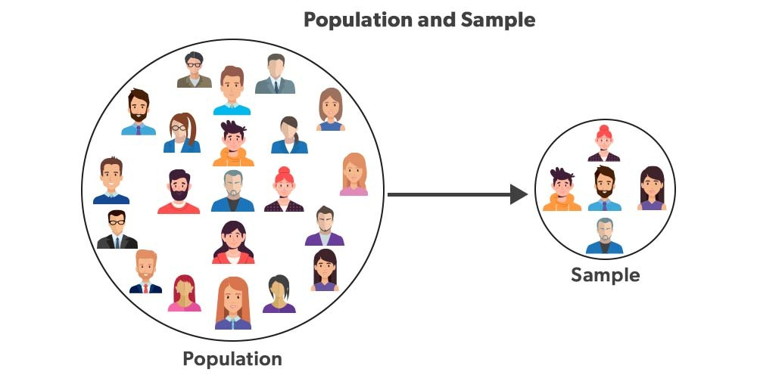
Explanation of each symbol 𝜇=∑𝑋/𝑁
​Where:
μ (mu) = population
meanΣ = summation (add all values)
X = each individual value
N = total number of population elements
Explanation:
Large circle = population Small circle = sample
Population = everything Sample = subset

Slide 5
Practical example
Population: All houses in Ahmedabad
Goal: Predict house price
Population = all houses
Sample = 10,000 houses dataset
Machine learning learns from sample but tries to generalize to population
Types of population:
Finite population
Example: Students in one class (50 students)
Infinite population
Example: All future stock prices

Slide 6
Advantages
Defines the true distribution
Provides complete information
Represents real-world scenario fully
Disadvantages
Usually impossible to collect full population data
Too expensive
Too time consuming
Population is used when:
You define the target group
Example:
All customers
All patients
All houses

Slide 7
When NOT to use
You never directly use full population in machine learning.
Instead, you use sample.
Population is theoretical reference.
Technical deep explanation
Machine learning assumes:
Training data sample ∼ Population distribution
Goal: Learn function:𝑓(𝑥)≈𝑡𝑟𝑢𝑒𝑝𝑜𝑝𝑢𝑙𝑎𝑡𝑖𝑜𝑛𝑓𝑢𝑛𝑐𝑡𝑖𝑜𝑛
Population distribution is unknown
Sample approximates population
Summary
Population = complete dataset of interest
It represents real-world data
Machine learning tries to learn population patterns from sample data

Slide 8
TOPIC 2: Sample
Definition:
A Sample is a subset taken from the population.
It is used to represent the population.
Why this exists
Because population is too large to study fully.
Sample makes analysis possible.
Machine learning trains on sample data.
Real-life analogy
Population = all mangoes in India
Sample = 100 mangoes you test
You estimate taste from sample.

Slide 9
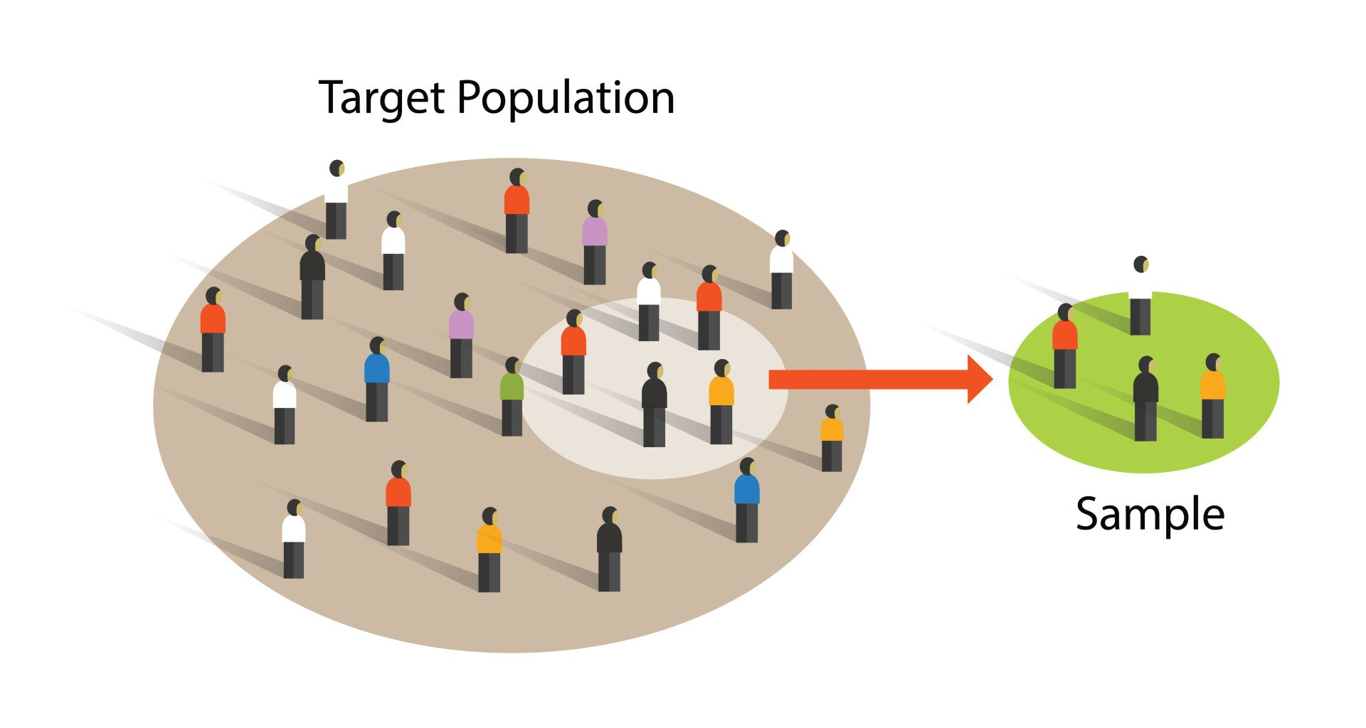
Mathematical Formula
Sample size:𝑛
Sample mean:𝑥ˉ=∑𝑋/𝑛 ​
Explanation of symbols
𝑥ˉ̄ = sample mean
Σ = sum
X = individual value
n = sample size
Practical example
Population: All customers
Sample: 10,000 customers
Train ML model on sample

Slide 10
Types
Random sampling
Stratified sampling
Systematic sampling
Advantages
Faster
Cheaper
Practical
Disadvantages
May not represent full population perfectly
Sampling bias possible

Slide 11
When to use
Always used in ML
ML never trains on full population
When NOT to use
Impossible to avoid sample in ML
Technical explanation
Sample approximates population distribution:
𝑃𝑠𝑎𝑚𝑝𝑙𝑒(𝑥)≈𝑃𝑝𝑜𝑝𝑢𝑙𝑎𝑡𝑖𝑜𝑛(𝑥)
Summary
Sample = subset of population used for training ML model

Slide 12
TOPIC 3: Variable Types
Definition
Variable = measurable property
Example: Height, Weight, Gender, Age
Why exists
ML models learn relationships between variables
Variables = inputs and outputs
Real-life analogy
Recipe example:
Ingredients = variables
Dish taste = output variable

Slide 13
Mathematical representation
𝑋=𝑖𝑛𝑑𝑒𝑝𝑒𝑛𝑑𝑒𝑛𝑡𝑣𝑎𝑟𝑖𝑎𝑏𝑙𝑒
𝑌=𝑑𝑒𝑝𝑒𝑛𝑑𝑒𝑛𝑡𝑣𝑎𝑟𝑖𝑎𝑏𝑙𝑒
Explanation
X = input
Y = output
Types
Two main types:
Quantitative
Qualitative

Slide 14
Quantitative Variables
Definition
Numeric values
Example:Height, Weight
Types: Continuous, Discrete
Continuous Variable
Definition:Can take infinite values
Example:Height = 170.1, 170.12, etc
Discrete Variable
Definition:Countable values
Example:Number of students1,2,3

Slide 15
Qualitative Variable
Definition: Category values
Example: Male/Female
Binary Variable
Two categories
Yes/No
Categorical Variable
Multiple categories
Red, Blue, Green
Summary
Variables are building blocks of ML models

Slide 16
TOPIC 4: Central Tendency
Central tendency is one of the most important foundations of statistics and machine learning.
It answers a very simple but powerful question:
"What is the center of the data?“
It includes:
Mean
Median
Mode

Slide 17
PART 1: MEAN
Definition:
The Mean is the average value of a dataset.
It is calculated by adding all values and dividing by total number of values.It represents the "center" of the data.
We need mean because:
• It summarizes large data into one number
• Helps understand overall trend
• Used in almost every ML algorithm
• Used to measure error, variance, and loss
Machine learning models try to minimize error relative to mean.
Real-life analogy
Imagine marks of 5 students:50, 60, 70, 80, 90
Mean = average performance of class
Instead of looking at 5 numbers, we use 1 number.

Slide 18
Mathematical Formula
Population mean:𝜇=∑𝑋/𝑁
​Sample mean:𝑥ˉ=∑𝑋/𝑛
​Explanation of each symbol
μ = population mean
x̄ = sample mean
Σ = sum of all values
X = individual value
N = population size
n = sample size

Slide 19
Practical example
Dataset:2, 4, 6, 8, 10
Step 1: Add all values 2+4+6+8+10 = 30
Step 2: divide by count 30 / 5 = 6
Mean = 6
Types
Population mean (μ)
Sample mean (x̄)
Weighted mean
Weighted mean formula:𝑥ˉ=∑(𝑤𝑖𝑥𝑖)/∑𝑤𝑖
​Advantages
Simple to calculate
Uses all data points
Very useful in ML

Slide 20
Disadvantages
Sensitive to outliers
Example:2, 3, 4, 5, 100
Mean = 22.8
But most values are near 3–5
Mean distorted by outlier.
When to use
Use when data has no extreme outliers.
Used in: Linear regression, Variance, Standard deviation, Gradient descent
When NOT to use
Do not use when data has extreme outliers.
Example: Income data, Few billionaires distort mean.

Slide 21
Technical deep explanation
Mean minimizes squared error
Mean is solution to: min⁡∑(𝑥−𝜇)^2
This is why linear regression predicts mean.
Summary
Mean = average
Represents center of data
Very important in ML optimization

Slide 22
PART 2: MEDIAN
Definition
Median is the middle value when data is sorted.
Why exists
Mean is affected by outliers.
Median is more robust.
Slide 4: Real-life analogy
Income example:10k, 20k, 30k, 40k, 10 crore
Median = 30k
More realistic than mean.

Slide 23
Mathematical formula
If odd number of values:𝑀𝑒𝑑𝑖𝑎𝑛=𝑚𝑖𝑑𝑑𝑙𝑒𝑣𝑎𝑙𝑢𝑒
If even number:𝑀𝑒𝑑𝑖𝑎𝑛=𝑚𝑖𝑑𝑑𝑙𝑒1+𝑚𝑖𝑑𝑑𝑙𝑒2/2
Explanation
Sort data first.
Then pick middle.
Example
Data:2,4,6,8,10
Median = 6
Even example:2,4,6,8
Median = (4+6)/2 = 5

Slide 24
Types
No major types
But used in: Robust statistics
Advantages
Not affected by outliers
Better representation sometimes
Disadvantages
Does not use all values
Less mathematically useful in ML

Slide 25
When to use
When outliers exist
Income, House prices
When NOT to use
When mathematical optimization required
Technical explanation
Median minimizes absolute error:
min⁡∑∣𝑥−𝑚𝑒𝑑𝑖𝑎𝑛∣
Used in MAE loss.
Summary
Median = middle value
Robust to outliers

Slide 26
PART 3: MODE
Definition
Mode = most frequent value
Why exists
Used to find most common category
Real-life analogy
Most common shoe size in store
Formula
No formula
Frequency-based
Explanation
Count frequency
Highest frequency = mode

Slide 27
Example
Data:1,2,2,3,4
Mode = 2
Types
Unimodal (1 mode)
Bimodal (2 modes)
Multimodal
Advantages
Useful for categorical data
Disadvantages
Not useful for continuous data
When to use
Categorical data
Example: Gender, Color

Slide 28
When NOT to use
Continuous numeric data
Technical explanation
Mode estimates peak of probability distribution.
Summary
Mode = most frequent value
Comparison Table
Measure Best Use
Mean General purpose
Median Outliers present
Mode Categorical data

Slide 29
TOPIC 5: Population Mean vs Sample Mean
PART 1: Population Mean
Definition
Population mean is the average value of the entire population.
It represents the true average of all possible data.
Why this concept exists
Population mean represents the true real-world value.
Machine learning tries to estimate this value using sample data.
Since population is usually unknown, we estimate it.
Real-life analogy
Imagine: You want average height of all humans on Earth.
Population mean = true average height of all humans.
But you cannot measure everyone.
So population mean exists theoretically.

Slide 30
Mathematical Formula
𝜇=∑𝑖=1𝑁𝑋𝑖𝑁
Explanation of each symbol
μ = population mean
Σ = sum of all values
Xi = each individual value
N = total population size
Practical example
Population:
Heights of all students in India
Population mean = true average height

Slide 31
Mathematical Formula
𝜇=∑𝑖=1𝑁𝑋𝑖/𝑁
Explanation of each symbol
μ = population mean
Σ = sum of all values
Xi = each individual value
N = total population size
Practical example
Population: Heights of all students in India
Population mean = true average height

Slide 32
Types
Only one population mean exists per population.
Advantages
Represents true real-world average
Disadvantages
Impossible to calculate in real world usually
When to use
Used as theoretical reference
When NOT to use
Cannot use directly in ML because population unknown
Technical deep explanation
Population mean defines expected value:𝜇=𝐸[𝑋]
Expected value means long-term average.
Summary
Population mean = true average of full population
Usually unknown

Slide 33
PART 2: Sample Mean
Definition
Sample mean is the average of sample data.
It estimates population mean.
Why exists
Because population mean is unknown.
Sample mean is used to estimate it.
Machine learning uses sample mean everywhere.
Real-life analogy
Population = all mangoes
Sample = 100 mangoes
Sample mean = estimate of population mean

Slide 34
Mathematical Formula
𝑥ˉ=∑𝑋𝑖/𝑛
Explanation
x̄ = sample mean
Xi = sample value
n = sample size
Practical example
Sample:2,4,6,8,10
Mean:(2+4+6+8+10)/5 = 6
Types
Simple mean
Weighted mean
Advantages
Easy to calculate
Used in ML training

Slide 35
Disadvantages
May differ from population mean
Sampling error exists
When to use
Always used in machine learning
When NOT to use
Never avoid sample mean
Technical deep explanation
Sample mean is unbiased estimator:𝐸[𝑥ˉ]=𝜇
Meaning sample mean approximates population mean.
Summary
Sample mean estimates population mean
ML models use sample mean

Slide 36
TOPIC 6: Measures of Variability
Central tendency tells center.
Variability tells spread.
Spread is CRITICAL in ML.

Slide 37
PART 1: RANGE
Definition
Range = difference between maximum and minimum value
Why exists
Shows how wide data is spread
Real-life analogy
Temperature: Min = 10°C, Max = 40°C
Range = 30°C
Formula
𝑅𝑎𝑛𝑔𝑒=𝑋𝑚𝑎𝑥−𝑋𝑚𝑖𝑛
Explanation
Xmax = maximum value
Xmin = minimum value

Slide 38
Example
Data:2,4,6,8,10
Range = 10−2 = 8
Types
No major types
Advantages
Simple
Disadvantages
Sensitive to outliers
When to use
Quick spread estimate

Slide 39
When NOT to use
Outlier heavy data
Technical explanation
Range ignores internal distribution
Summary
Range = max − min

Slide 40
PART 2: VARIANCE (EXTREMELY IMPORTANT)
Definition
Variance measures how far data is spread from mean.
Why exists
Mean alone is insufficient.
Variance measures spread.
Machine learning minimizes variance.
Real-life analogy
Two classes:
Class A:50,50,50,50
Variance = 0
Class B:10,50,90,130
High variance

Slide 41
Formula
Population variance:𝜎^2=∑(𝑋−𝜇)^2/𝑁
Sample variance: 𝑠^2=∑(𝑋−𝑥ˉ)^2/𝑛−1
Explanation
σ² = population variance
s² = sample variance
X = value
μ = population mean
x̄ = sample mean
N = population size
n = sample size

Slide 42
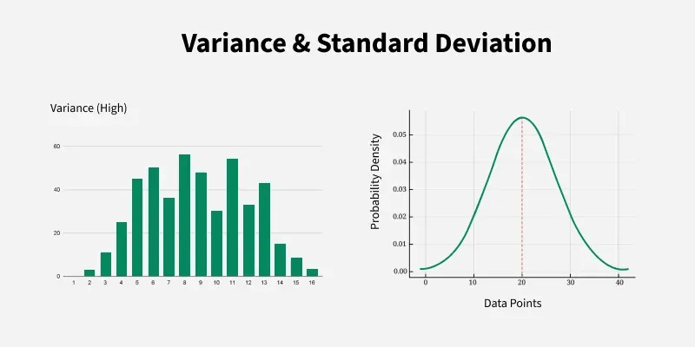
Example
Data:2,4,6
Mean = 4
Variance:(2−4)²+(4−4)²+(6−4)² = 4+0+4 = 8/3 = 2.67

Slide 43
Types
Population variance
Sample variance
Advantages
Measures true spread
Used in ML optimization
Disadvantages
Units squared
When to use
Always in ML
When NOT to use
Never avoid variance

Slide 44
Technical deep explanation
Variance measures expected squared deviation:
𝑉𝑎𝑟(𝑋)=𝐸[(𝑋−𝜇)^2]
Used in:
Bias-variance tradeoff
Loss functions
Summary
Variance measures spread from mean
Extremely important in ML

Slide 45
PART 3: STANDARD DEVIATION (SD)
Definition
Standard Deviation tells us how far data values usually are from the mean.
It is the square root of variance, so it brings the unit back to normal.
Why this concept exists
Variance is useful but hard to interpret because units are squared.
Uses the same unit as data
Is easier to understand
Is widely used in ML, statistics, and finance
Real-life analogy
Marks of students:
Class A: all students score around 60
Class B: some score 20, some 100
Class B has higher standard deviation.

Slide 46
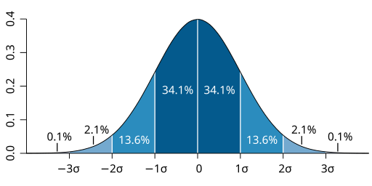
Mathematical Formula
Population standard deviation:𝜎=√∑(𝑋−𝜇)^2/𝑁
​Sample standard deviation:𝑠=√∑(𝑋−𝑥ˉ)^2/𝑛−1
​Explanation of each symbol
σ = population standard deviation
s = sample standard deviation
X = data point
μ = population mean
x̄ = sample mean
N = population size
n = sample size
Visual explanation (diagram)
Diagram: Spread around mean
Explanation: Narrow curve → low SD, Wide curve → high SD

Slide 47
Practical example
Data: 2, 4, 6
Mean = 4
Deviations:(2−4)² = 4, (4−4)² = 0, (6−4)² = 4
Variance = 8/3 = 2.67
Standard deviation = √2.67 ≈ 1.63
Types
Population SD
Sample SD
Advantages
Easy to interpret
Used everywhere in ML
Same unit as data

Slide 48
Disadvantages
Affected by outliers
When to use
Always in ML
Data normalization
Model evaluation
When NOT to use
When extreme outliers dominate data
Technical deep explanation
Standard deviation measures expected deviation from mean.
Used in: Z-score, Normal distribution
Feature scaling
Summary
Standard deviation = typical distance from mean

Slide 49
PART 4: INTERQUARTILE RANGE (IQR)
Slide 2: Definition
IQR measures spread of the middle 50% of data.
It ignores extreme values.
Slide 3: Why exists
Mean and SD are sensitive to outliers.
IQR is robust.
Slide 4: Real-life analogy
Income data:Few billionaires
Many average earners
IQR focuses on middle group.

Slide 50
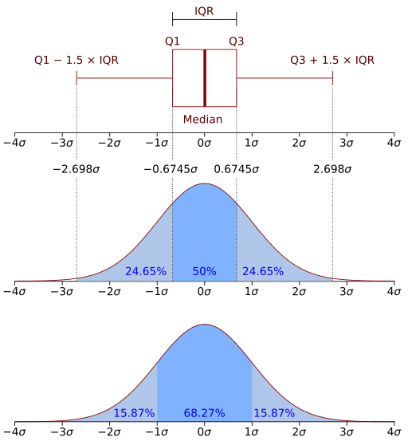
Mathematical Formula
𝐼𝑄𝑅=𝑄3−𝑄1
Explanation
Q1 = 25th percentile
Q3 = 75th percentile
Visual explanation
Diagram: Box plot
Practical example
Data:1,2,3,4,5,6,7,8
Q1 = 3
Q3 = 7
IQR = 7 − 3 = 4

Slide 51
Types
No major types
Advantages
Not affected by outliers
Robust measure
Disadvantages
Ignores extreme values completely
When to use
Outlier-heavy data:
Income
House prices

Slide 52
When NOT to use
When full data spread is required
Technical deep explanation
IQR is used in outlier detection:
Outlier if:
𝑋<𝑄1−1.5(𝐼𝑄𝑅) or 𝑋>𝑄3+1.5(𝐼𝑄𝑅)
Summary
IQR = spread of middle 50%

Slide 53
TOPIC 7: COVARIANCE
Definition
Covariance measures how two variables change together.
Why exists
Machine learning learns relationships between variables.
Covariance tells: Do they increase together? Or move opposite?
Real-life analogy
Temperature ↑ → Ice cream sales ↑Positive covariance.
Mathematical Formula
𝐶𝑜𝑣(𝑋,𝑌)=∑(𝑋−𝑥ˉ)(𝑌−𝑦ˉ)/𝑛

Slide 54
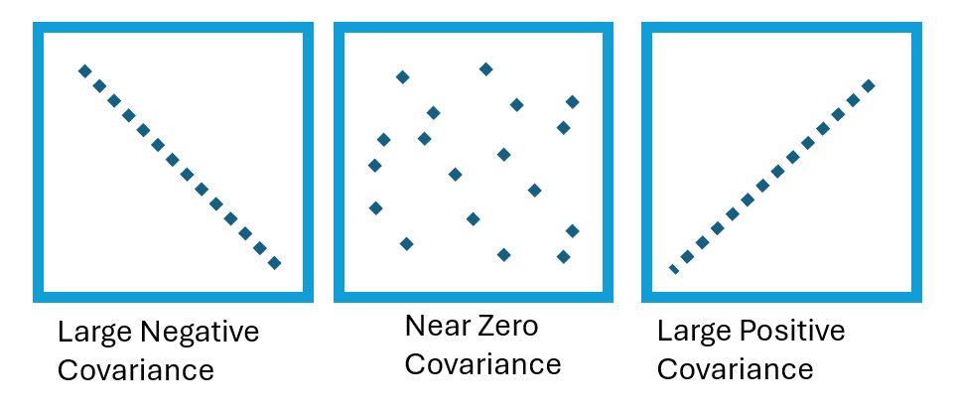
Slide 6: Explanation
X, Y = variables
x̄, ȳ = means
Positive → move together
Negative → move opposite
Visual explanation

Slide 55
Practical example
Height ↑ → Weight ↑
Positive covariance.
Types
Positive covariance
Negative covariance
Zero covariance
Advantages
Shows direction of relationship
Disadvantages
Magnitude hard to interpret

Slide 56
When to use
Feature relationship analysis
When NOT to use
When comparing scale-independent relationships
Technical deep explanation
Covariance is base for correlation and PCA.
Summary
Covariance = joint variability

Slide 57
TOPIC 8: CORRELATION
Definition
Correlation measures strength and direction of relationship between two variables.
Why exists
Covariance magnitude is unclear.
Correlation normalizes it.
Real-life analogy
Study hours ↑ → Marks ↑
Strong positive correlation.

Slide 58
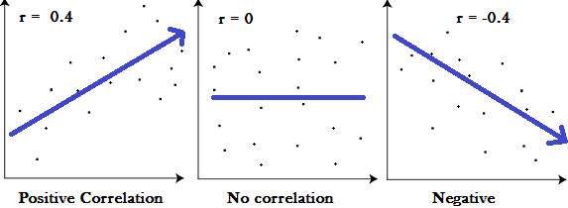
Mathematical Formula
𝑟=𝐶𝑜𝑣(𝑋,𝑌)𝜎𝑋𝜎𝑌
​Explanation
r ranges from:-1 to +1
+1 → perfect positive
-1 → perfect negative
0 → no relationship
Visual explanation

Slide 59
Practical example
Height & weight → r ≈ 0.7
Types
Positive
Negative
Zero
Advantages
Easy interpretation
Scale-independent
Disadvantages
Does not imply causation
When to use
Feature selection
EDA

Slide 60
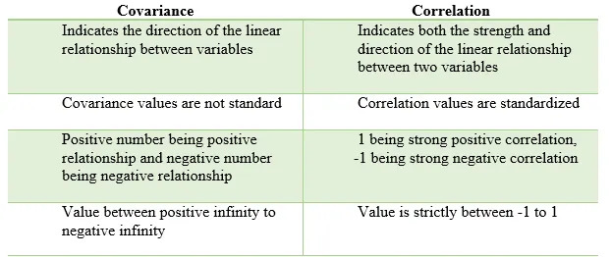
When NOT to use
Non-linear relationships
Technical deep explanation
Assumptions: Linearity, Normality, Homoscedasticity
Summary
Correlation measures linear relationship strength

Slide 61
TOPIC 9: DISTANCE
Distance is the foundation of many ML algorithms like:
• KNN • KMeans • SVM • Clustering
Machine learning often works by measuring how "close" or "far" data points are.
Definition
Distance measures how far apart two data points are.
It tells how similar or different two points are.
Small distance → similar Large distance → different

Slide 62
Why this concept exists
Machine learning needs to compare data points.
Example:
Face recognition compares distance between faces.
Closer distance = same person.
Real-life analogy
Distance between two cities.
Ahmedabad to Mumbai = 500 km
Ahmedabad to Gandhinagar = 25 km
Gandhinagar is more similar geographically.

Slide 63
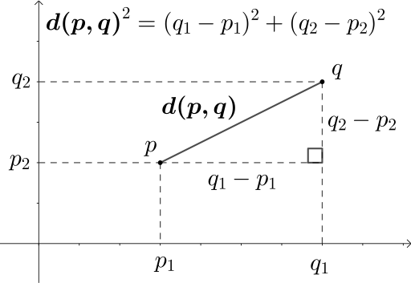
Mathematical Formula (Euclidean Distance)
Most important distance formula:
𝑑=√(𝑥1−𝑥2)^2+(𝑦1−𝑦2)^2
​Explanation of symbols
d = distance
(x1, y1) = first point
(x2, y2) = second point
Visual explanation
Diagram: Distance between two points

Slide 64
Practical example
Point A: (2,3)
Point B: (5,7)
Distance: √(5−2)^2+(7−3)^2 = √9+16 = √25 ​= 5
Most important distance types:
Euclidean distance
Manhattan distance
Minkowski distance
Manhattan distance formula:∣𝑥1−𝑥2∣+∣𝑦1−𝑦2∣
Advantages
Simple
Used everywhere

Slide 65
Disadvantages
Sensitive to scale
When to use
KNN
Clustering
Similarity problems
When NOT to use
When features have different scales (need normalization)
Technical deep explanation
Distance defines geometric space.
ML models create decision boundaries based on distance.
Summary
Distance measures similarity between data points.

Slide 66
TOPIC 10: LINEARITY
Definition
Linearity means relationship between variables forms a straight line.
Why exists
Many ML models assume linear relationship.
Example: Linear regression
Real-life analogy
If salary increases steadily with experience → linear relationship
Mathematical Formula
Linear equation:𝑦=𝑚𝑥+𝑏y=mx+b

Slide 67
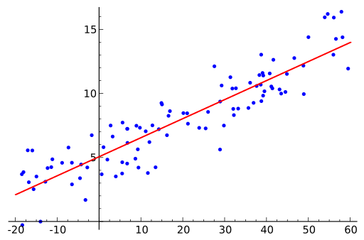
Explanation
y = output
x = input
m = slope
b = intercept
Visual explanation:
Practical example
Experience vs Salary
Straight line relationship
Types
Positive linear
Negative linear

Slide 68
Advantages
Easy modeling
Disadvantages
Cannot capture complex patterns
When to use
Linear regression
When NOT to use
Non-linear data
Technical deep explanation
Linear models assume:𝐸[𝑌∣𝑋]=𝑎𝑋+𝑏
Summary
Linearity = straight line relationship

Slide 69
TOPIC 11: NORMALITY
Definition
Normal distribution is bell-shaped distribution.
Most values lie near mean.
Why exists
Many ML models assume normal distribution.
Real-life analogy
Human heights follow normal distribution.
Most people average height.
Few very tall or short.

Slide 70
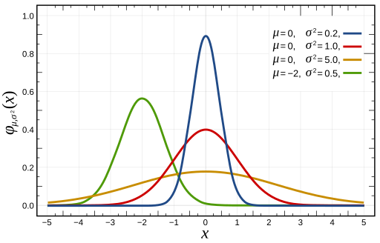
Mathematical Formula
𝑓(𝑥)=1/𝜎√2𝜋*𝑒^−(𝑥−𝜇)^2/2𝜎^2
Explanation
μ = mean
σ = standard deviation
Visual explanation
Practical example
IQ scores
Most around 100
Types
Standard normal distribution

Slide 71
Advantages
Mathematically convenient
Disadvantages
Real data not always normal
When to use
Statistical tests
When NOT to use
Skewed data
Technical deep explanation
Central Limit Theorem makes many distributions normal.
Summary
Normal distribution = bell curve

Slide 72
TOPIC 12: HOMOSCEDASTICITY
Definition
Homoscedasticity means that the spread (variance) of errors remains constant across all values of the input variable.
In simple words: The prediction errors should be evenly spread everywhere.
Why this concept exists
Machine learning models assume that errors behave consistently.
If error spread changes, model assumptions break.
This affects:
• Linear regression accuracy
• Confidence intervals
• Statistical tests

Slide 73
Real-life analogy
Imagine throwing darts at a dartboard.
Case 1 (Homoscedastic):Darts spread evenly around center everywhere.
Case 2 (Heteroscedastic):Near center → tight spread, Far from center → wide spread
Machine learning prefers Case 1.
Mathematical Formula
Error term:𝑉𝑎𝑟(𝜖𝑖)=𝜎^2
Explanation of each symbol
Var(εi) = variance of error
εi = error for ith data point
σ² = constant variance
Meaning: Variance must remain constant.

Slide 74
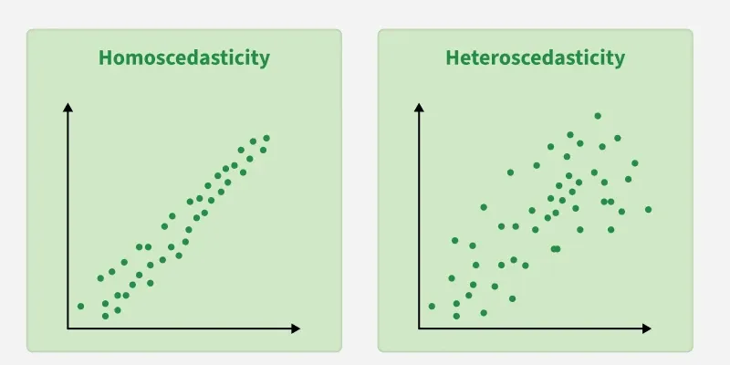
Visual explanation (diagram)
Diagram: Homoscedastic vs Heteroscedastic
Practical example
Predict salary from experience.
Good case: Error spread same for all experience levels.
Bad case: Low experience → small error, High experience → large error
Bad case violates homoscedasticity.
Types
Homoscedasticity (good)
Heteroscedasticity (bad)
Advantages
Ensures reliable model performance
Accurate statistical inference
Improves regression validity

Slide 75
Disadvantages
Rare in real-world data
Often violated
When to use
Linear regression
Statistical modeling
Inferential statistics
When NOT to use
When data clearly shows changing variance
Use robust models instead like:
Decision Trees
Random Forest

Slide 76
Technical deep explanation
Linear regression assumes:𝐸(𝜖𝑖^2)=𝑐𝑜𝑛𝑠𝑡𝑎𝑛𝑡
Violation causes:
• inefficient parameter estimation
• incorrect confidence intervals
Summary
Homoscedasticity means constant error variance.
It is required for linear regression validity.

Slide 77
TOPIC 13: OUTLIERS
Definition
Outlier is a data point that is extremely different from other data points.
It lies far away from normal range.
Why this concept exists
Outliers affect machine learning models by:
• Distorting mean
• Increasing variance
• Reducing model accuracy
Outliers can come from:
Measurement errors
Rare events
FraudNoise

Slide 78
Real-life analogy
Income example:10k, 12k, 15k, 18k, 20k, 10 crore
10 crore ← Outlier
This one value distorts average.
Mathematical Formula (IQR Method)
Outlier detection rule:
Lower bound:𝑄1−1.5(𝐼𝑄𝑅)
Upper bound:𝑄3+1.5(𝐼𝑄𝑅)
Explanation of symbols
Q1 = 25th percentile
Q3 = 75th percentile
IQR = Q3 − Q1
Any value outside bounds = outlier

Slide 79
Practical example
Data:1,2,3,4,5,6,7,100
Q1 = 3
Q3 = 7
IQR = 4
Upper bound:7+1.5(4)=13
100 > 13 → outlier
Types of Outliers
Point outlier: Single extreme value
Contextual outlier: Abnormal in specific context
Collective outlier: Group of abnormal values
Advantages
Help detect fraud
Help detect rare events
Help detect data errors

Slide 80
Disadvantages
Distort ML models
Distort mean
Reduce accuracy
When to use
Fraud detection
Anomaly detection
Medical diagnosis
When NOT to use
When they are measurement errors
Must remove them before training ML model.

Slide 81
Technical deep explanation
Outliers increase loss function value.
Example MSE loss:𝑀𝑆𝐸=1/𝑛*∑(𝑦−𝑦^)^2
Outliers create large squared error.
This heavily affects training.
Summary
Outliers are extreme values.
They must be detected and handled properly.

Slide 82
TOPIC 14: Hypothesis
Definition
A Hypothesis is an assumption or claim about data that we want to test.
It is a statement that can be proven true or false using data.
Why this concept exists
We use hypothesis because we need to make decisions based on data.
Machine learning models also test hypotheses internally.
Examples:
• Does studying more increase marks?
• Does medicine reduce fever?
• Does house size affect price?
Hypothesis testing helps confirm if relationship is real.

Slide 83
Real-life analogy
Imagine a doctor says: “This medicine works.”
This is a hypothesis.
We test it on patients to verify.
Mathematical Representation
Hypothesis is written as:𝐻
Usually two hypotheses exist:𝐻0 and 𝐻1
​Explanation of symbols
H = Hypothesis
H₀ = Null Hypothesis
H₁ = Alternative Hypothesis
These represent competing claims.

Slide 84
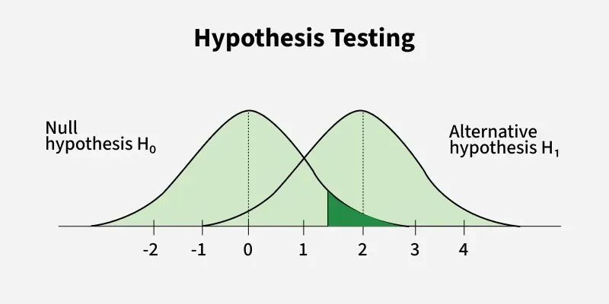
Visual explanation
Diagram: Hypothesis testing distribution
Practical example
Hypothesis: “Students who study more score higher.”
We test this using data.

Slide 85
Types
Null hypothesis (H₀)
Alternative hypothesis (H₁)
Advantages
Helps make data-driven decisions
Foundation of statistical testing
Used in ML feature selection
Disadvantages
Requires sufficient data
Incorrect hypothesis can mislead
When to use
Scientific testing
Machine learning
Medical testing
A/B testing

Slide 86
When NOT to use
When no data exists
Pure intuition-based problems
Technical deep explanation
Hypothesis testing uses probability theory.
We test whether observed data is consistent with assumed hypothesis.
Mathematically:𝑃(𝐷𝑎𝑡𝑎∣𝐻𝑦𝑝𝑜𝑡ℎ𝑒𝑠𝑖𝑠)
If probability is very low → reject hypothesis
Summary
Hypothesis = assumption about data
It is tested using statistical methods
Foundation of ML model evaluation

Slide 87
TOPIC 15: Null Hypothesis (H₀)
Definition
Null hypothesis assumes: “There is NO relationship or NO effect.”
It assumes everything is due to chance.
Why this concept exists
Null hypothesis acts as default assumption.
We assume nothing special is happening unless proven otherwise.
Real-life analogy
Court example: Person is assumed innocent until proven guilty.
Null hypothesis = innocent
Alternative hypothesis = guilty

Slide 88
Mathematical representation
𝐻0:𝜇= μ₀
​Explanation
H₀ = null hypothesis
μ = population mean
μ₀ = assumed mean
Actual mean equals assumed mean
No effect exists.
Example:
H₀: Studying has no effect on marks
Types
Equality hypothesis:H₀: μ = μ₀
Advantages
Provides baseline
Allows objective testing

Slide 89
Disadvantages
May not represent real world
When to use
Always used in hypothesis testing
When NOT to use
Never skipped in statistical testing
Technical deep explanation
Null hypothesis defines probability distribution.
Statistical tests measure deviation from null hypothesis.
Summary
Null hypothesis assumes no effect.
We try to reject it using data.

Slide 90
TOPIC 16: Alternative Hypothesis (H₁)
Definition
Alternative hypothesis assumes: “There IS a real relationship or effect.”
Why exists
Alternative hypothesis represents actual claim.
Real-life analogy
Court example: Alternative hypothesis = guilty
Mathematical representation
𝐻1:𝜇≠𝜇0 ​or 𝐻1:𝜇>𝜇0 ​or 𝐻1:𝜇<𝜇0 ​

Slide 91
Explanation
Means actual mean differs from assumed mean.
Practical example
H₁: Studying increases marks
Types
Two-tailed test
One-tailed test
Advantages
Represents real effect
Disadvantages
Harder to prove
When to use
When testing real-world claims

Slide 92
When NOT to use
Always used alongside null hypothesis
Technical deep explanation
If probability of data under null hypothesis is very low, alternative hypothesis accepted.
Summary
Alternative hypothesis represents real effect.

Slide 93
TOPIC 17: P-Value
This concept is used everywhere in:
• Machine Learning
• Feature Selection
• Medical Research
• A/B Testing
• Model Evaluation
Definition
The P-value is the probability of getting the observed result (or something more extreme) assuming the Null Hypothesis is true.
In simple words: P-value tells us how likely the observed result happened by chance.

Slide 94
Why this concept exists
We need a way to decide: Is this result real? Or just random? P-value helps us make this decision objectively.
Machine learning uses P-values in:
• Feature selection
• Statistical testing
• Model validation
Real-life analogy
Imagine flipping a coin.
Null hypothesis: Coin is fair.
You flip coin 10 times and get 10 heads.
This is very unlikely.
P-value will be very small.
This suggests coin may not be fair.
Mathematical Definition
𝑃-value=𝑃(observed data∣𝐻0)

Slide 95
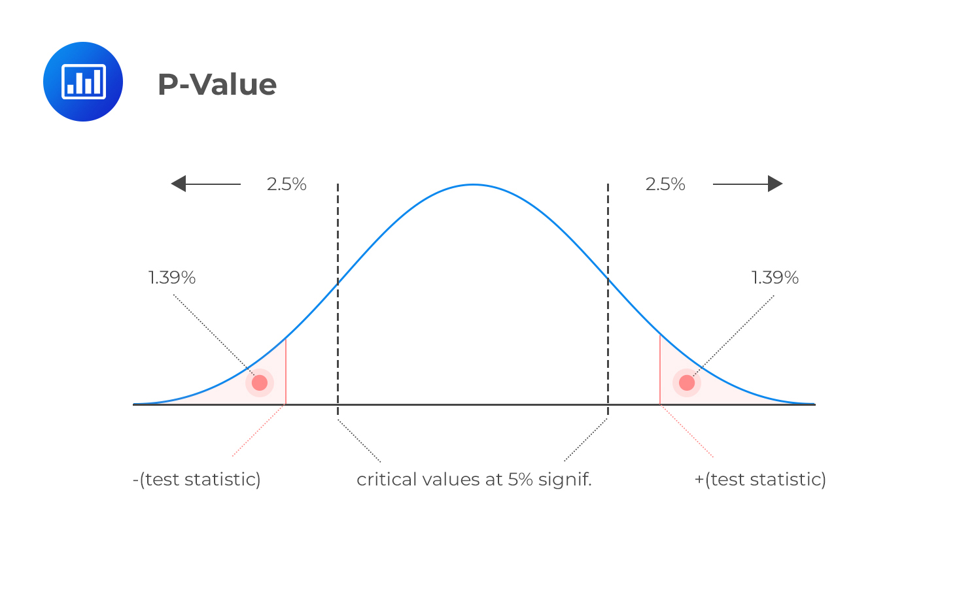
Explanation of symbols
P = probability
Observed data = actual measured result
H₀ = null hypothesis
Meaning: Probability of observing data assuming null hypothesis is true.
Visual explanation
Diagram: P-value as tail area

Slide 96
Example:
H₀: Studying has no effect on marks
Experiment shows strong improvement.
P-value = 0.001
This means only 0.1% chance result happened randomly.
So reject null hypothesis.
Types
No major types, but interpretation levels exist
Common thresholds:0.05, 0.01, 0.001
Advantages
Objective decision making
Widely used
Foundation of statistical testing
Disadvantages
Misinterpreted often
Does not measure effect size

Slide 97
When to use
Feature selection
Hypothesis testing
Scientific experiments
When NOT to use
When sample size too small
When assumptions violated
Technical deep explanation
Decision rule:
If:𝑃<0.05, Reject null hypothesis.
If:𝑃>0.05 Fail to reject null hypothesis.
This threshold is called significance level (α).
Summary
P-value measures probability of observing result by chance.
Small P-value → strong evidence against null hypothesis.

Slide 98
TOPIC 18: T-Value (Test Statistic)
This is the numerical value used to calculate P-value.
Definition
T-value measures how far sample mean is from population mean in units of standard error.
In simple words: It tells how extreme the result is.
Why this concept exists
We need a numerical measure to determine how unusual data is.
Larger T-value → stronger evidence against null hypothesis.

Slide 99
Real-life analogy
Imagine exam average:
Expected average = 50
Observed average = 90
This difference is large → high T-value
Mathematical Formula
𝑡=𝑥ˉ−𝜇/𝑠/√𝑛
​Explanation of symbols
t = T-value
x̄ = sample mean
μ = population mean
s = sample standard deviation
n = sample size
s/√n = standard error
Standard error measures uncertainty in mean.

Slide 100
Practical example
Sample mean = 60
Population mean = 50
Standard deviation = 10
Sample size = 25
𝑡 = 60−50/10/√25 ​= 10/2 = 5
Large T-value = strong evidence.
Types
Positive T-value
Negative T-value
Advantages
Quantifies difference
Used to compute P-value

Slide 101
Disadvantages
Requires normality assumption
When to use
T-test
Hypothesis testing
When NOT to use
Very large datasets (use Z-test)
Technical deep explanation
T-value measures standardized distance from null hypothesis mean.
Higher absolute T-value → lower P-value
Summary
T-value measures how extreme sample result is.

Slide 102
TOPIC 19: T-Test
The T-test is one of the most widely used statistical tests in machine learning and data science.
It helps answer: “Are two averages significantly different, or is the difference just random?”
Definition
A T-test is used to determine whether the difference between two means is statistically significant.
In simple words: It checks if two averages are truly different or just different due to chance.
Why this concept exists
We need to compare averages in many real-world problems.
Examples:
• Does new medicine work better than old medicine?
• Do students who study more score higher?
• Does new ML feature improve model performance?
T-test helps answer these objectively.

Slide 103
Real-life analogy
Suppose two classes take an exam.
Class A average = 60
Class B average = 65
Question: Is Class B actually better? Or difference happened randomly?
T-test answers this.
Mathematical Formula
One-sample T-test formula: 𝑡=𝑥ˉ−𝜇/𝑠/√𝑛 ​
Two-sample T-test formula: 𝑡=𝑥ˉ1−𝑥ˉ2/√𝑠1^2/𝑛1+𝑠2^2/𝑛2 ​ ​
Explanation of symbols
t = T-value
x̄₁, x̄₂ = sample means
μ = population mean
s₁, s₂ = standard deviations
n₁, n₂ = sample sizes

Slide 104
Practical example
Class A mean = 60
Class B mean = 80
If T-test gives P-value = 0.001
Conclusion: Difference is statistically significant.
Three important types:
One-sample T-test: Compare sample mean to population mean
Two-sample T-test: Compare two independent groups
Paired T-test: Compare same group before and after change
Advantages
Simple
Widely used
Powerful statistical test

Slide 105
Disadvantages
Assumes normal distribution
Sensitive to outliers
When to use
Compare two means
Feature selection
A/B testing
When NOT to use
More than two groups (use ANOVA instead)
Technical deep explanation
T-test measures signal vs noise ratio:
Signal = difference between means
Noise = variation in data
Higher signal → reject null hypothesis.
Summary
T-test compares means and determines if difference is real.

Slide 106
TOPIC 20: ANOVA (Analysis of Variance)
ANOVA is an extension of T-test.
Definition
ANOVA tests whether the means of three or more groups are significantly different.
Why this concept exists
T-test compares only 2 groups.
ANOVA compares multiple groups.
Example: Compare performance of 3 ML models.
Real-life analogy
Compare exam scores of: Class A, Class B, Class C
ANOVA determines if any class differs significantly.

Slide 107
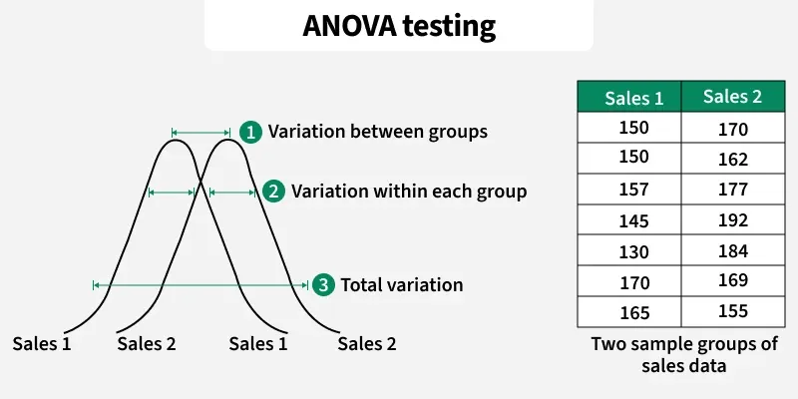
Mathematical Formula
F-statistic formula:𝐹=variance between groups/variance within groups
Explanation
F = test statistic
Higher F → greater difference between groups
Visual explanation

Slide 108
Practical example
Compare accuracy of 3 ML models:
Model A: 80%
Model B: 85%
Model C: 95%
ANOVA checks if differences are statistically significant.
Types
One-way ANOVA
Two-way ANOVA
Advantages
Compare multiple groups
Efficient

Slide 109
Disadvantages
Does not identify which group differs
When to use
Compare multiple ML models
Feature selection
When NOT to use
Only 2 groups (use T-test)
Technical deep explanation
ANOVA compares variance: Between-group variance, Within-group variance
Higher ratio → reject null hypothesis.
Slide 15: Summary
ANOVA compares multiple group means.

Slide 110
TOPIC 21: Chi-Square Test
This is extremely important in machine learning for categorical features.
Definition
Chi-square test determines whether two categorical variables are related.
Why exists
Machine learning often works with categorical data.
Chi-square helps determine feature importance.
Real-life analogy
Does smoking affect lung disease?
Chi-square tests relationship.

Slide 111
Mathematical Formula
𝜒2=∑(𝑂−𝐸)^2/𝐸
Explanation
χ² = Chi-square value
O = observed value
E = expected value
Practical example
Test if gender affects product purchase.
Types
Test of independence
Test of goodness-of-fit
Advantages
Works with categorical data
Feature selection

Slide 112
Disadvantages
Requires sufficient sample size
When to use
Categorical feature selection
When NOT to use
Continuous data
Technical deep explanation
Measures difference between observed and expected frequencies.
Summary
Chi-square tests relationship between categorical variables.

